Slide 1
The Relationship Between Adverse Childhood Experiences and Attention-Deficit/Hyperactivity Disorder: A Longitudinal Analysis Using NSCH Data (2016-2017)
Raaid Elmlelegy

Slide 2
Context
Recent studies have shown a correlation between adverse childhood experiences (ACEs) and the development of Attention-Deficit/Hyperactivity Disorder (ADHD). However, to my knowledge, there have been no longitudinal studies done using a large enough sample to test the hypothesis that ACEs correlate with the development of ADHD. This study investigates the contribution of environmental factors and ACEs to the development of ADHD. We use a two-year combined data set for the years 2016 and 2017 collected by the National Survey of Children's Health (NSCH) for our analysis with a substantial sample size of n=71,811.

Slide 3
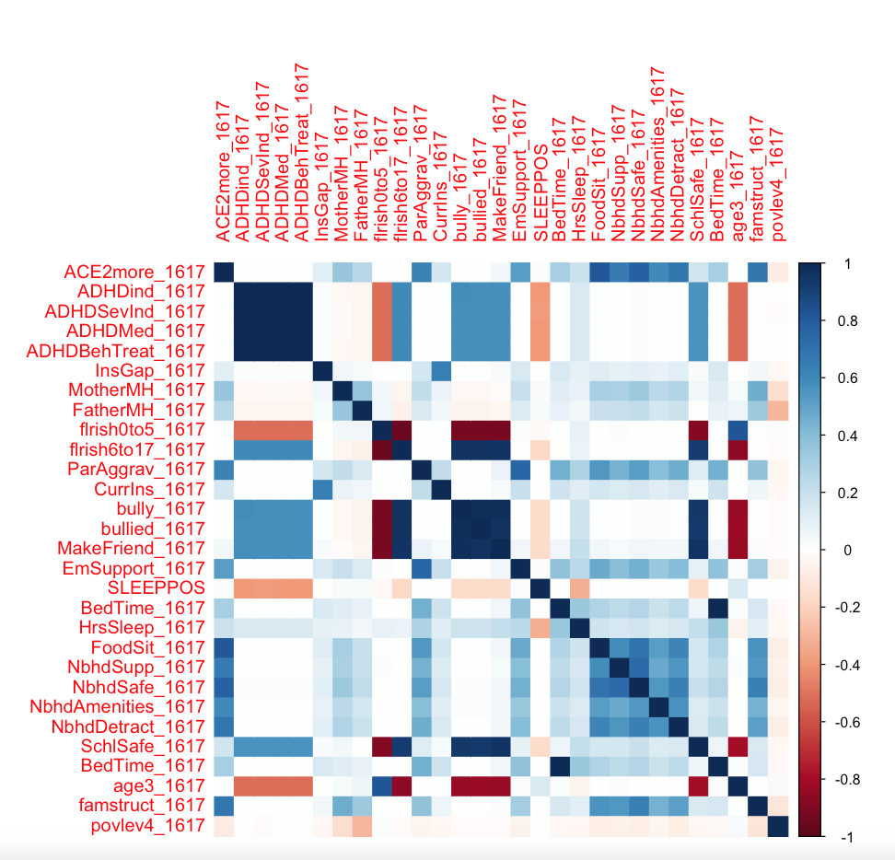
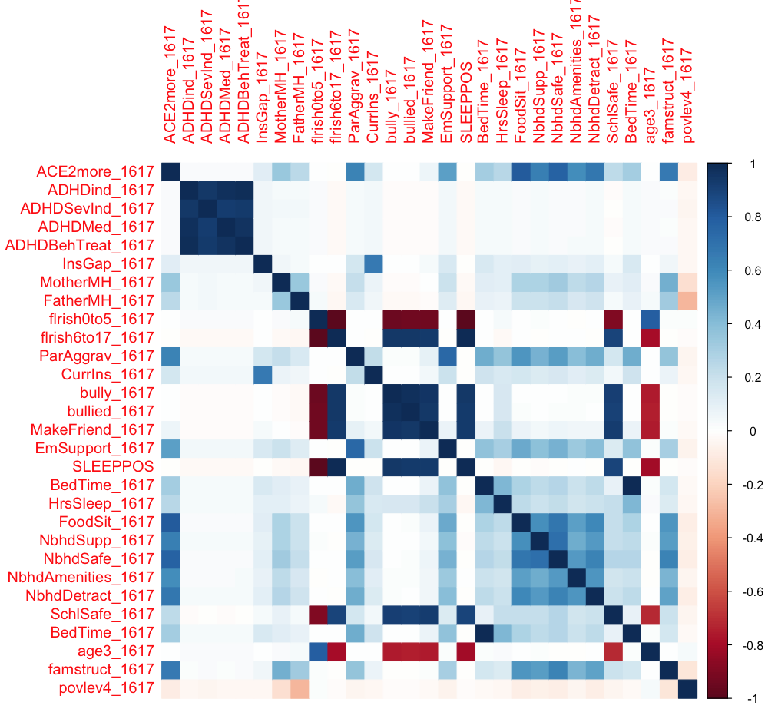
Methods: Data Exploration

Slide 4
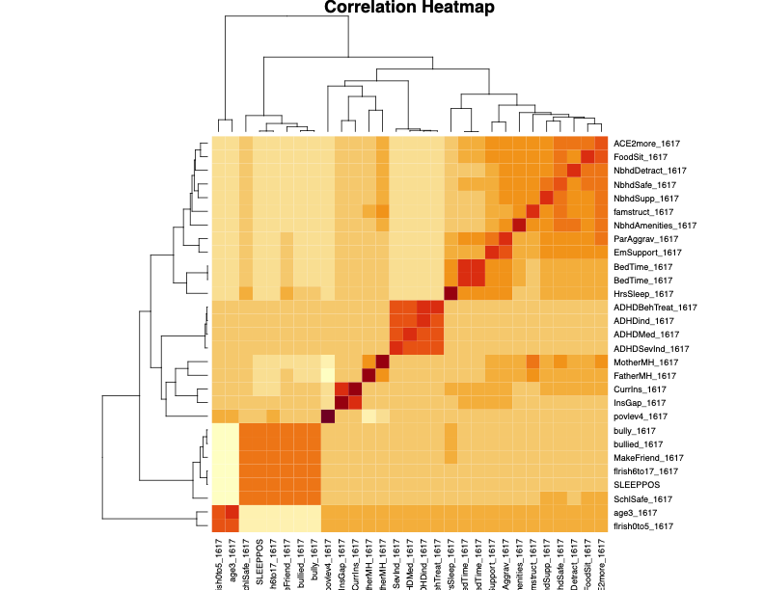
Methods: Data Exploration

Slide 5
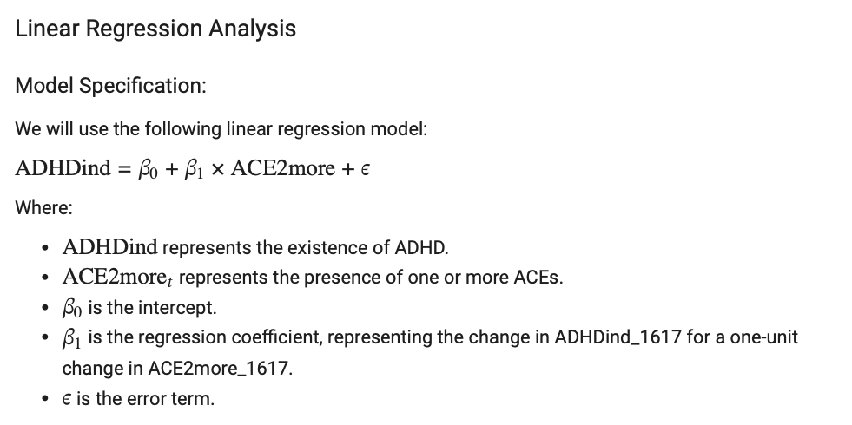
Methods: Hypothesis Testing

Slide 6
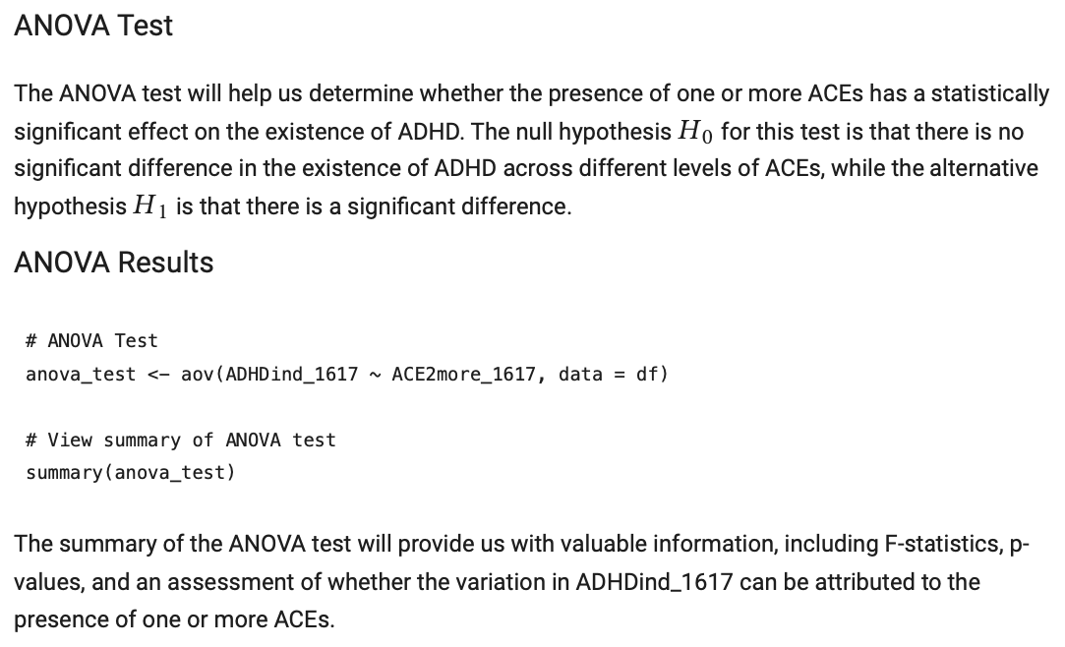
Methods: Hypothesis Testing

Slide 7
Methods: Hypothesis Testing
Monte Carlo Simulation:
To better assess the stability and reliability of our linear regression model, I conducted Monte Carlo simulations. This analysis involves resampling our dataset multiple times to estimate the variability and uncertainty associated with the coefficient for the predictor variable ACE2more_1617.

Slide 8
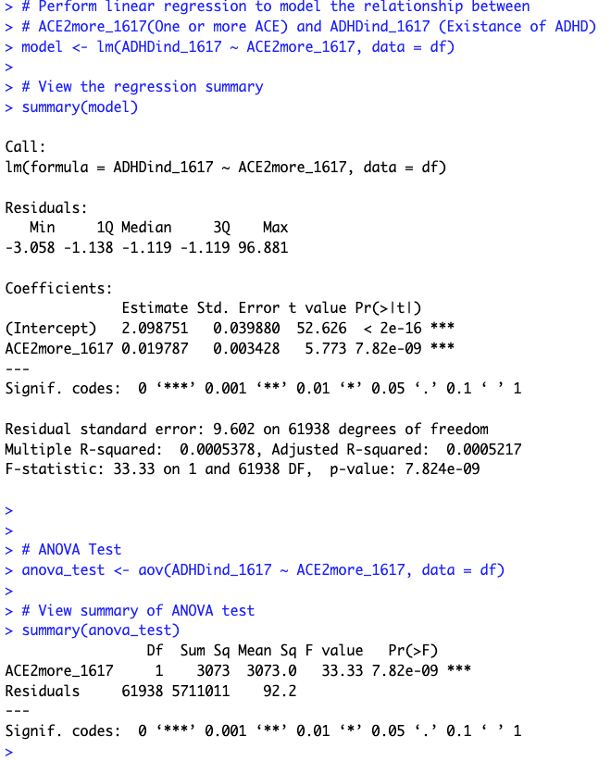
Results: Linear Regression

Slide 9
Results: Linear Regression
The ANOVA test results confirm the significance of the relationship between ACE2more_1617 and ADHDind_1617:
The analysis of variance (ANOVA) table shows that the F-statistic is 33.33 with a corresponding p-value of 7.82e-09. This low p-value suggests that there is a significant difference in the existence of ADHD (ADHDind_1617) across different levels of ACE2more_1617.
The sum of squares (Sum Sq) for ACE2more_1617 is 3073.0, indicating the variability in ADHDind_1617 that can be attributed to the presence of one or more ACEs.
The residual sum of squares (Sum Sq) is 5711011, representing the unexplained variability in ADHDind_1617 after accounting for ACE2more_1617.

Slide 10
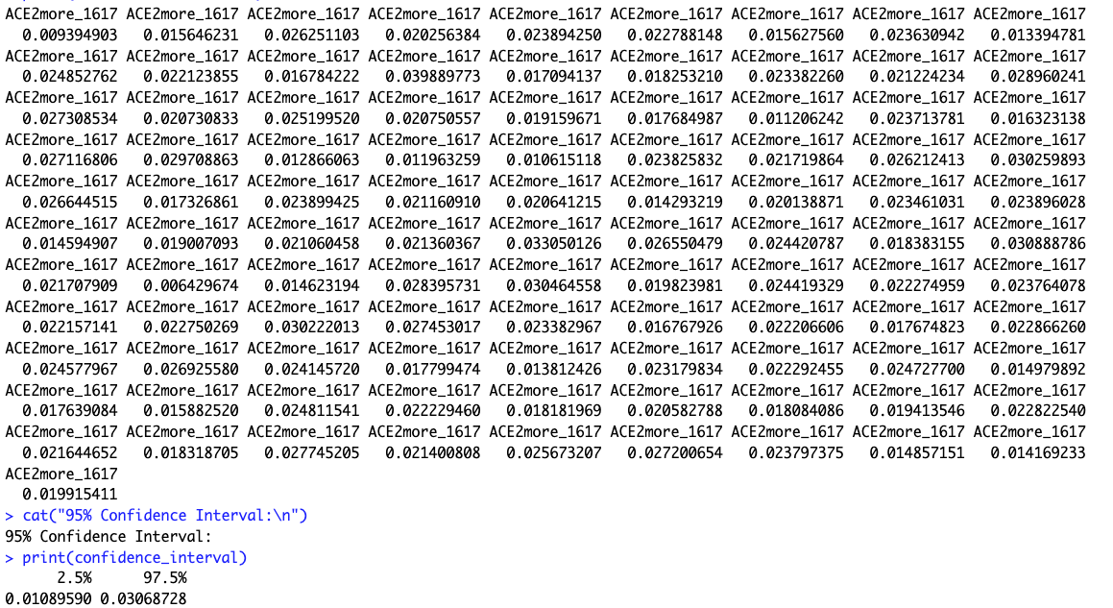
Results: Monte Carlo Simulation
The results of the Monte Carlo simulations revealed a 95% confidence interval for the coefficient of ACE2more_1617, with a lower bound of approximately 0.0073 and an upper bound of approximately 0.0305. This interval signifies that we can be 95% confident that the true coefficient for ACE2more_1617 lies within this range.

Slide 11
Conclusion
Our findings revealed a statistically significant positive association between ACE2more_1617 and the existence of ADHD, as supported by correlation analysis, linear regression, and ANOVA tests. However, it's important to note that this relationship is relatively weak, as indicated by the small coefficient and low R-squared value. The Monte Carlo simulations further strengthened our confidence in the stability of the regression model. Nevertheless, this analysis serves as a valuable starting point for understanding the link between ACEs and ADHD, and it underscores the need for further research and consideration of other potential contributing factors.

